Slide 1

Project :
ClimaSign
Team:
Symp-Aero
Membres :
Yousra Chouchene
Sarra Ben Bdira

Slide 2
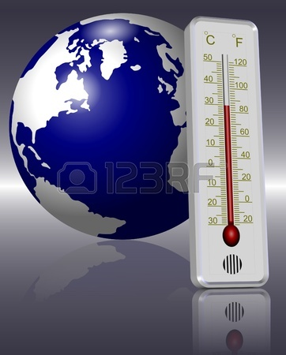
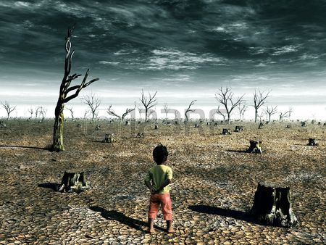
Introduction
Urban air pollution with climate change, increases the risk of acute respiratory disease (Asthma, Grippe).

Slide 3
Worldwide, it is estimated that 1.3 million die every year from urban pollution.
Annual influenza attack rate is estimated over 10%.
Annual epidemics are responsible for approximately 500 000 deaths.

Slide 4

SOLUTION
Making a connected Watch that will be able to know the climate change and the physical conditions for a person
Thus, to identify his health state regarding its susceptibility to catching a worldwide epidemic disease (H1N1 )
define a public tool enabling the classification of these symptoms depending on their frequency , using NASA databases on a map
create a source of prevention to the entire population.

Slide 5
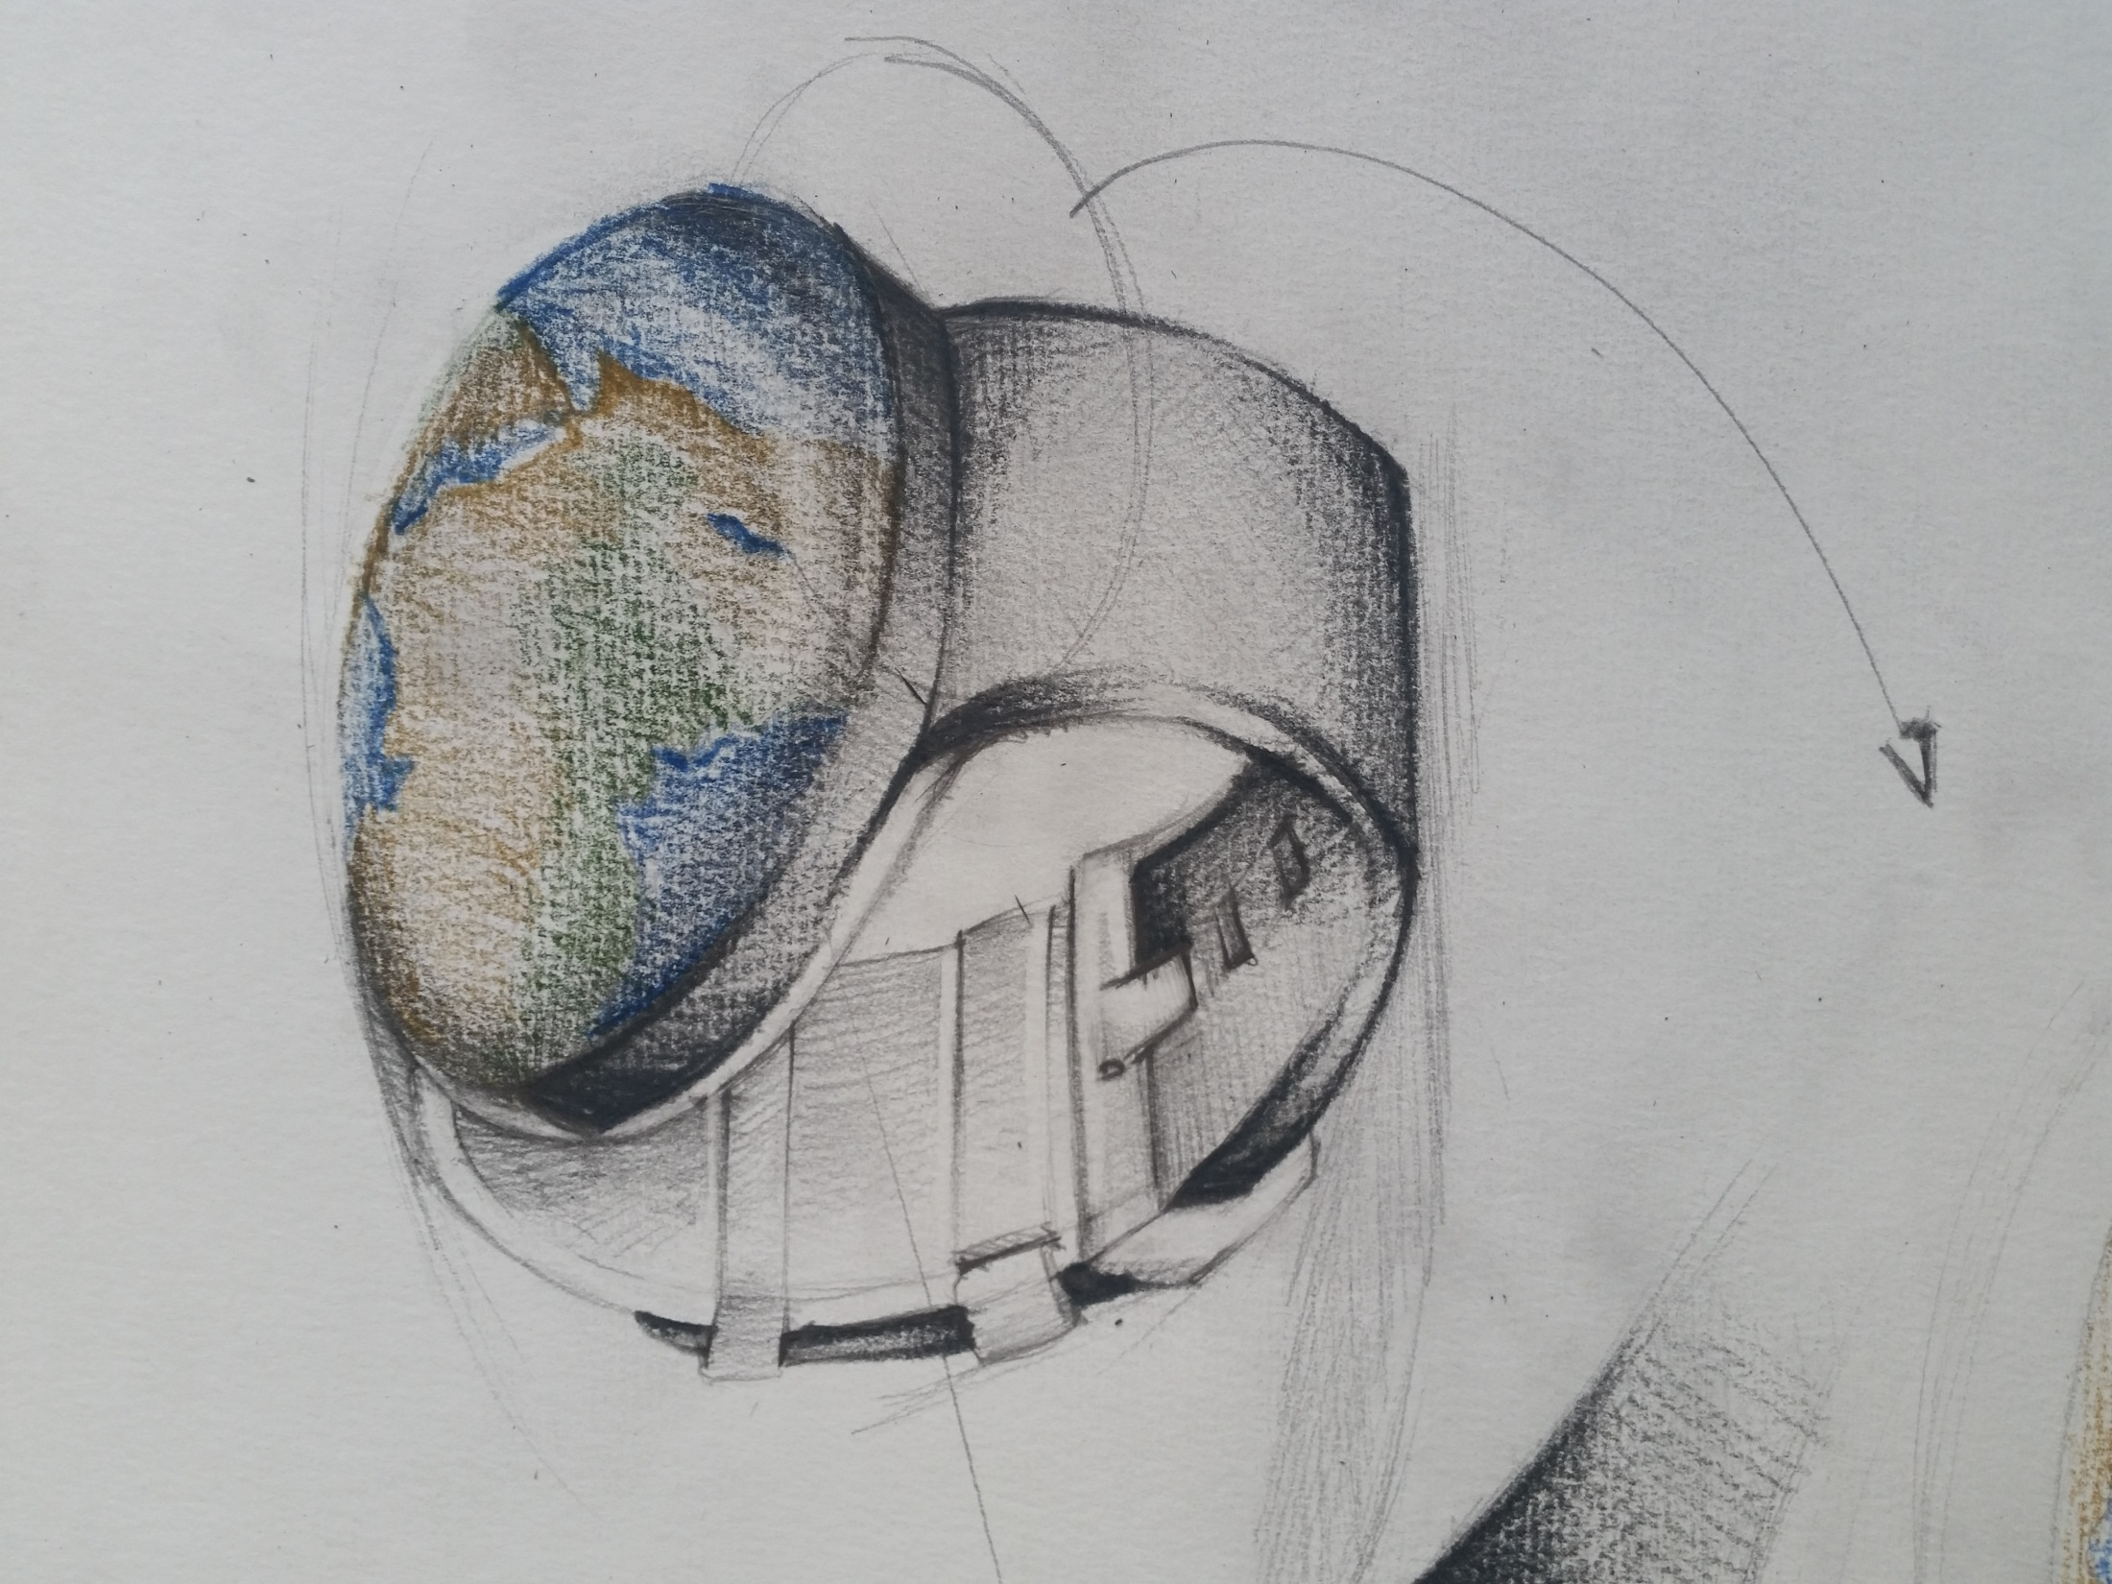
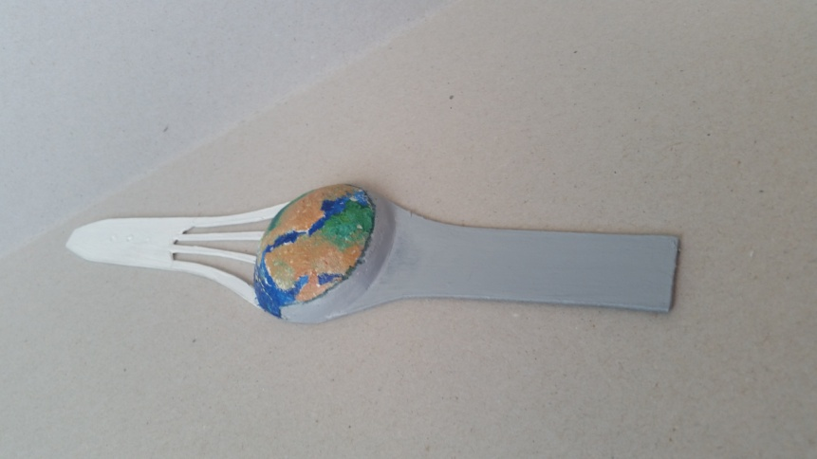
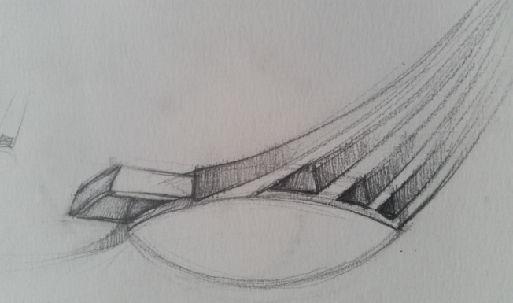
ClimaWatch
Elements :
- Sensors of Fine Particle ( virus)
- Sensor of Heat
-GPS

Slide 6
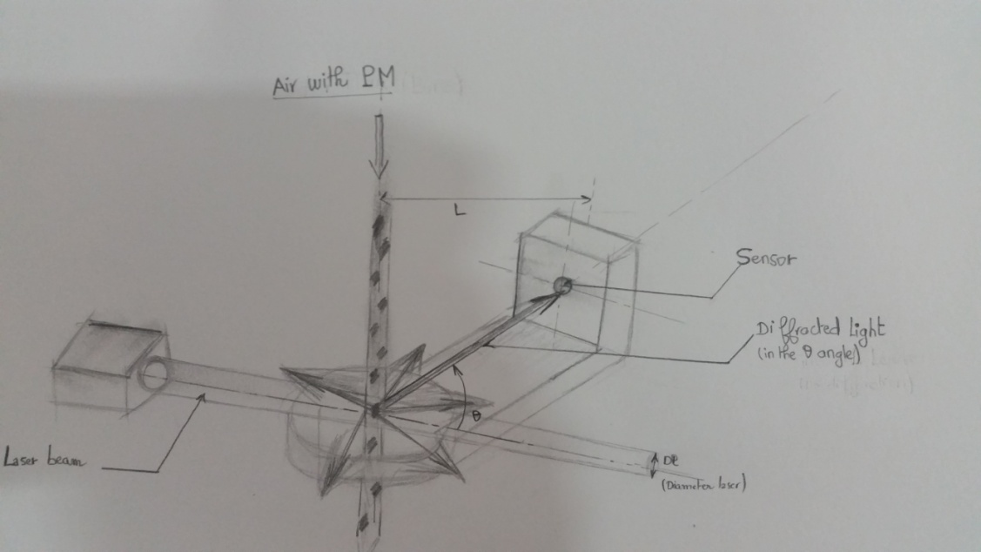
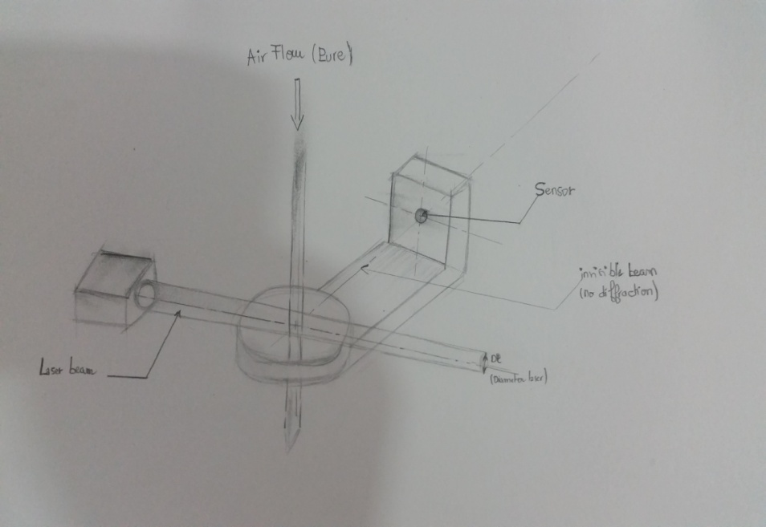
Sensors of Fine Particle ( virus)
Size’s sensor : Probe fine particle detector (PFD)
It uses laser diffraction technology . when a laser beam passes through pure air, the beam is invisible.
When the beam is visible, this is because the beam is diffracted onto particles along its path.

Slide 7
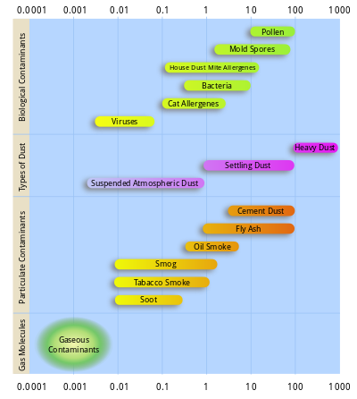
PM10 (PM10 is particulate matter with a mean aerodynamic diameter of 10 μm)
-Inhalable particle : between 2.5 and 10 microns (dusty industries)
-PM2.5 ; Fine particles with a diameter of 2.5 μm or less ( smoke )
PM 1, very fine, the include ultrafine particles, most hazardous for health (such as viruses)

Slide 8
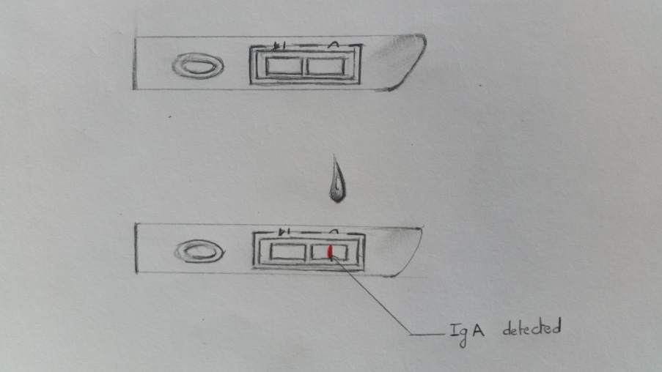
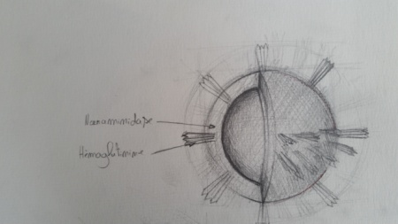
Type ’s sensor: Influenza Viruses
Biopatch : Sensor IgA present in sweat :
A rapid test based on the principle of an ELISA for detecting the presence antibodies (IgA) produced in the sweat once body is infected
It uses the same Ag (exp :H1) that gave birth to the Ac.
It looks for IgA anti-HA
a positive resultat : colored bands (red) appeared after 5 to 10 minutes

Slide 9

Fever Sensor:
A graphene plastic mixed with crystal liquid.
This thermosensor once has detected a body temperature superior then 38 °c, the watch will be able to change its color to red and the person will be so alarmed face this febrile state.
Our project has one more benefit : an integrated box containing an antipyretic pill ( 1g) which will be easy-accessible, thanks to an slip system.

Slide 10
GPS

Slide 11
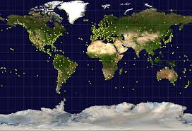

Benefits:
-it Allows a Spatial and temporal location of the person with respiratory symptoms (fever, sweat) and precisely who’s likely to be infected with H1N1, and then compared to the épidemic areas on a cartography
- Thus the person will be able to avoid regions with a high risk of contamination
-it compares the overall distribution of people with acute respiratory symtomatology with the distribution different concentrations of particles already given by NASA

Slide 12
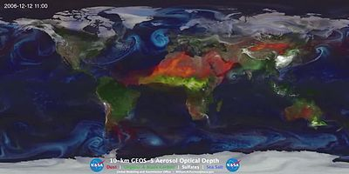
This shows aerosol optical thickness of transported key aerosols
(from 17 August 2006 to 10 April 2007, from a 10 km resolution GEOS-5 "nature run" using the GOCARTmodel, NASA)
green: organic carbon red/orange: dust white: sulfates

Slide 13

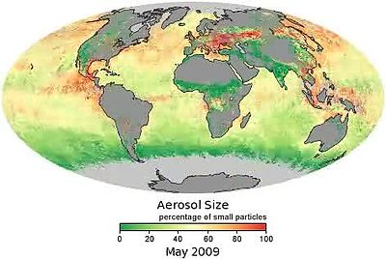
The distribution of aerosol particles, based on data from the Moderate Resolution Imaging Spectroradiometer (MODIS) on NASA's Terra satellite.
Green areas : larger particles. Red : dominated by small particles. Yellow : particles are mixing.

Slide 14

it Serves as a means to evaluate the efficiency of our usual means of prevention (against greenhouse gasses, the hygienic means..)
it evaluates its reel efficiency by estimating a decrease (or eventially an increase) number of people with respiratory signs and/or infected with flu virus.

Slide 15

According to the WHO,
a reduction from an annual average of 70 µg/m3 of PM10 to 20 µg/m3, is expected to yield a 15% reduction in mortality .

Slide 16

ClimaWatch seems to be a new tremendous project and a brainstroming idea in both technological and medical field
By opening a new horizon regarding the mesures of identification of population’s health state and evaluation of worldwild prevention
ClimaWatch can make science fiction true…

